Slide 1
Web Accessibility (A11y)
Josh Harrison, Intuit
Senior Software Engineer
Time Tracking/Payroll Accessibility Leader

Slide 2

Josh Harrison
Sr. Software Engineer, Intuit
Web Developer
Accessibility Champion
https://www.linkedin.com/in/jjharrison/

Slide 3
Why is Accessibility important?
What is Web Accessibility?
Inclusive Design & Diverse Abilities
Principles
Assistive technologies
What you can do

Slide 4
Why is Accessibility important?

Slide 5

Notes:
Apple – Accessibility – Sady (with Audio Descriptions)
https://www.youtube.com/watch?v=SL7YSqlEd8k

Slide 6
1 in 12 men have trouble differentiating colors (color blindness) - colourblindawareness.org
1 out of 7 people in the world has some sort of disability - World Health Organization
20% of the US Population has some sort of disability - US Census Bureau
98% of web home pages have accessibility issues - WebAIM Million Report

Slide 7
Why is Accessibility important?
“...a disability is not an intrinsic property of an individual, but a mismatch between the individual’s abilities and environment.”
- World Health Organization, Web Accessibility Context

Slide 8
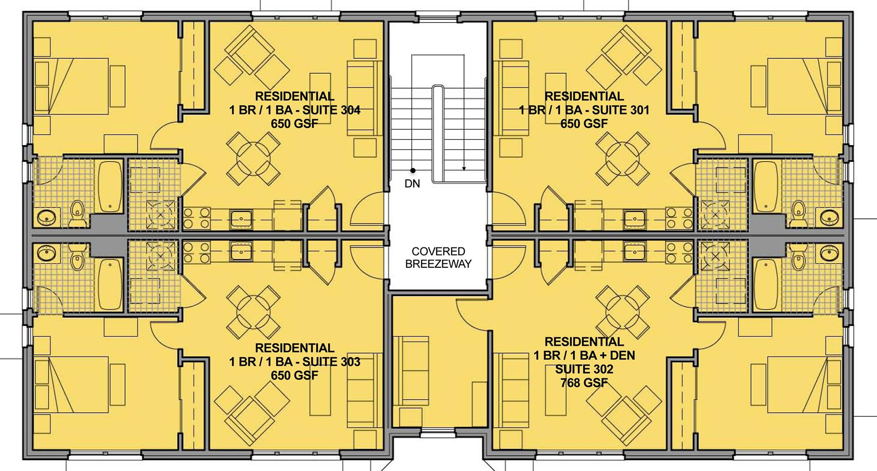
Importance of Inclusive Design
Notes:
Let’s pretend you are designing a building. You design the layout, where the restrooms will be located, the stairwell for entry/exit, and even which directions the doors should swing out when opened.

Slide 9
Importance of Inclusive Design
Notes:
But then halfway through construction you find out that one of the renter’s uses a wheelchair to get around, and you did not design the building with an elevator. Now you have to designate a space, probably common or shared space, and start construction of the elevator. This means relocating the existing infrastructure and building an elevator shaft in a place that doesn’t accommodate the shaft.
If you had only included people with disabilities in your original design, you would have made sure to accommodate an elevator that every resident in the building would be able to use.

Slide 10
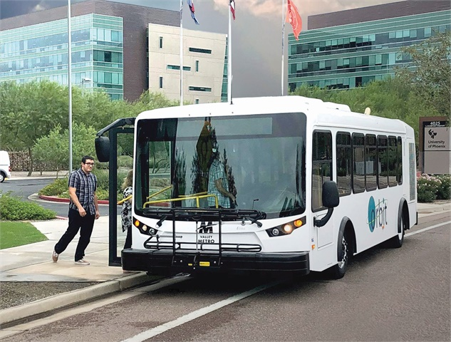

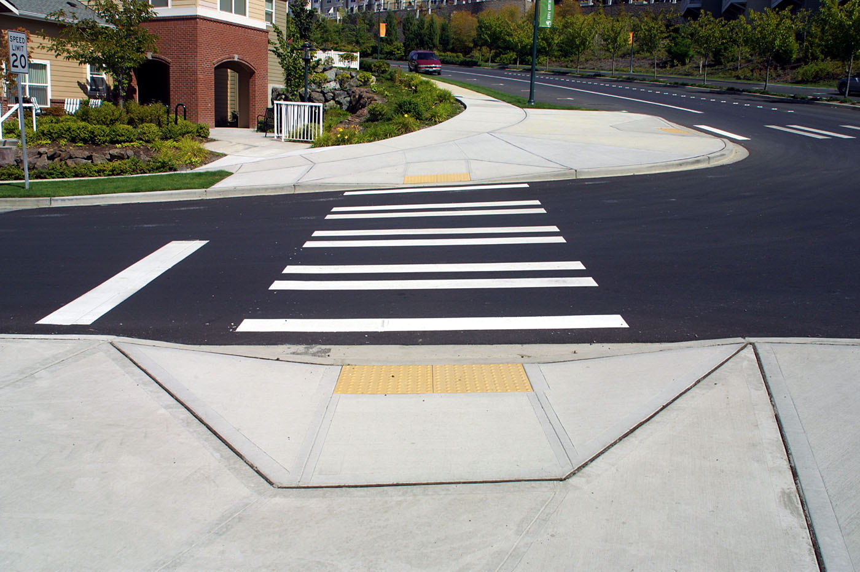

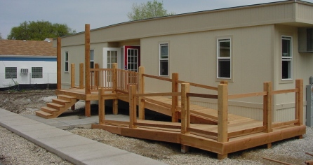
Accessibility benefits everyone!
Notes:
Examples of accessibility in the public space that everyone benefits from:
Metro bus that lowers to meet the cub height when it arrives, designed for people with wheelchairs and walkers. Used by everyone, including new parents pushing baby strollers, people pushing bicycles on/off the bus, someone who is fatigued
Elevators/escalators to gain access to upper-levels in buildings. Used by everyone, including parents with children, someone who is fatigued and can’t climb stairs (but doesn’t visibly look disabled), someone who uses a wheelchair.
Curb cutout, the original accessibility design for the public space, designed for people with wheelchairs to safely enter/exit the crosswalk. Used by everyone who takes a walk/job, by someone on a skateboard, by a family on a walk pushing a baby stroller.
Vegetable peelers, a very old, uncomfortable design for an every day tool. Redesigned to be ergonomic and more comfortable by an engineer whose wife began having severe arthritis and couldn’t hold the old peeler. This new peeler is now the standard we all expect to be available.
Building entry that has stairs and a ramp, giving people choices at that time. Someone using a wheelchair will use the ramp, and so will someone delivering a cart full of computer hardware. Someone without a disability would use the stairs, while someone with an invisible disability, like sickle cell disease, might use the ramp because the stairs will fatigue them

Slide 11
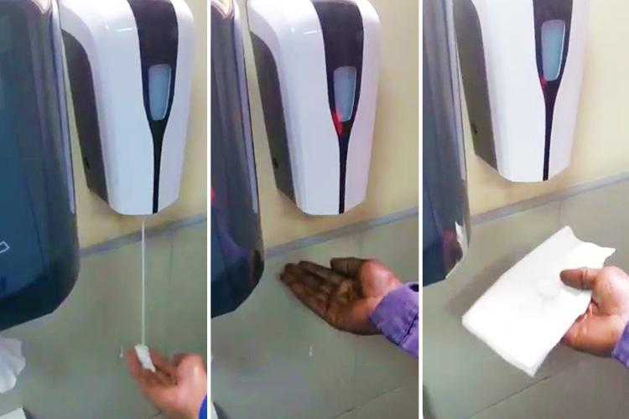
Failing to design inclusively
Notes:
Failing to design for all types of users can lead to disastrous (though unintentional) outcomes. Here we see a typical soap dispenser in a public restroom that has a light sensor to provide soap. The light sensor only works on someone’s hand that has a light skin-tone, while a darker skin-tone isn’t picked up by the light detector. This person has to put a white napkin on their hand to get soap as a workaround to a barrier caused by bad design.

Slide 12
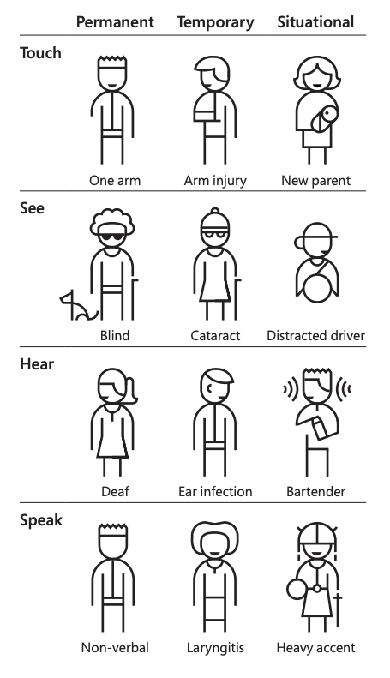
Diverse abilities
“Solve for one, extend to many”
Microsoft Inclusive Design Kit
Notes:
Examples of designing for permanent disabilities and extending those features to everyone including temporary, situation, and no disabilities. Microsoft tags this as “solving for one, extend to many.”

Slide 13
Web Accessibility principles
Websites, tools, and technologies are designed and developed so that people with disabilities can use them.
WWW is fundamentally designed to work for all people
WWW removes barriers to communication and interaction
Badly designed websites, applications, technologies, etc. introduce barriers
Many organisations are waking up to the fact that embracing accessibility leads to multiple benefits – strengthening brand presence, improving customer experience, colleague productivity, and reducing legal risks.
Paul Smyth, Head of Digital Accessibility, Barclays

Slide 14
Web Accessibility principles - POUR
Perceivable - people can see or hear the content
Operable - people can use the software via keyboard, mouse, voice, etc.
Understandable - people get clear and simple language
Robust - people can use different assistive technologies
Notes:
Perceivable -
The handling of media content like video, audio and imagery
The handling of text alternatives through things like captioning and sign language
The approach to the sequencing of content and layout
The handling of color and contrast
The control of text size and audio controls
The handling content interactions i.e. hover and focus states
Operable -
Keyboard operability
Time allowance
Seizures and other involuntary physical reactions
Navigation through things like focus order, page titles, links, headings and labels
Input methods like touch targets sizing, alternative input methods
Understandable -
Predictable and consistent navigation
Use of language such as abbreviations, jargon, reading levels
Predictable and consistent actionable components
Feedback and error handling
Help, such as contextual help and error prevention
Robust -
Parsing and generally ‘clean’ code like no duplicate attributes, complete start and end tags for elements
Name, role and value
Status messages, sending messaging to the user without interrupting their workflow by giving focus to an element. e.g. “added to cart” while shopping online should act as a message and not a redirection of activity and focus for the user.
https://medium.com/the-school-of-do/making-accessibility-accessible-the-pour-principles-f5ad21eda12f#:~:text=The%20good%20news%20is%20that,known%20as%20the%20POUR%20principles.

Slide 15
Assistive Technologies
Screen reader
Text-to-speech
Screen magnification
Custom color theming

Slide 16
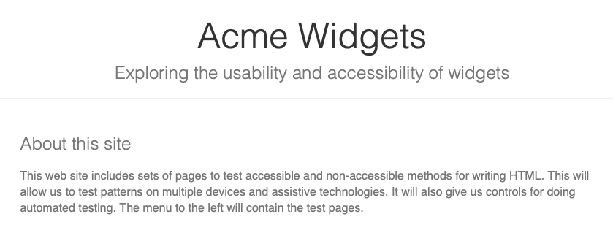
Using a screen reader
Accessibility Testing Site

Slide 17
What you can do
Use semantic HTML

Slide 18
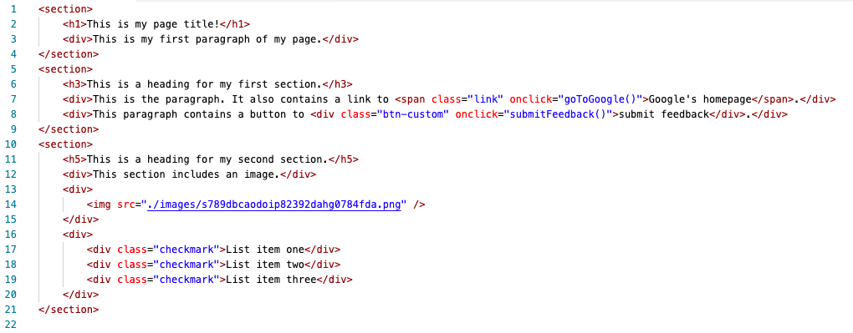
What you can do
Use semantic HTML
Notes:
This example of HTML uses div’s to contain text, it doesn’t comply with a good heading hierarchy, and uses elements that aren’t designed to be clicked as clickable controls. It also fails to provide alternative text to the image.

Slide 19
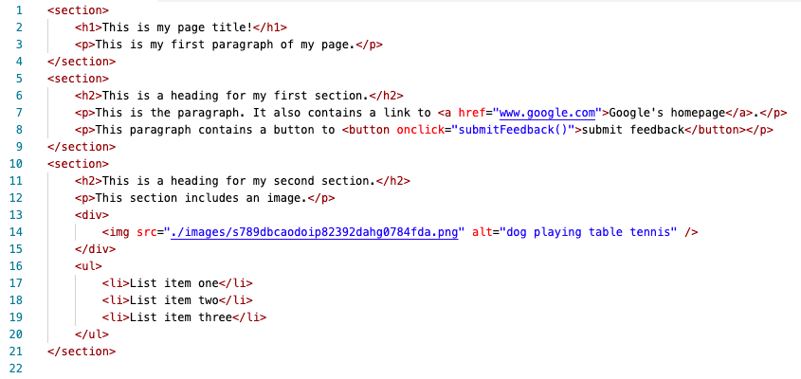
What you can do
Use semantic HTML
Notes:
This example of HTML is the same as the previous except that it uses semantic elements. For example, the link is now an anchor tag, and the button is a true button. The image contains alternative text, and the heading structure follows a hierarchy.

Slide 20


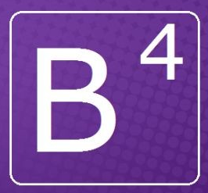

What you can do
Use semantic HTML
Use reusable UI components that are accessible
Vue.js Accessibility Basics

Slide 21
What you can do
Use semantic HTML
Use reusable UI components that are accessible
Test the UI using only your keyboard
tab / shift+tab to move forwards and backwards
enter to activate a button or a link
space to check/uncheck a checkbox
up/down/left/right to select a radio button in a radio button group

Slide 22
What you can do
Use semantic HTML
Use reusable UI components that are accessible
Test the UI using only your keyboard
Test the UI using a screen reader
Windows - download and use NVDA
Mac/iOS - use VoiceOver (built-in)
Android - use TalkBack (built-in)

Slide 23
Links to resources
Web Content Accessibility Guidelines (WCAG)
NVDA Shortcut Keys
MacOS VoiceOver Guide
Android TalkBack Guide
Vue.js Accessibility Basics
Accessibility Testing Site
https://github.com/joshharrison626/Intro-To-Accessibility

